Slide 1

GEOG 530: Global Land and Water Resources
Impacts of Cadmium-related soil pollution on vegetable production in China: A meta-analysis
Malolan R
261014344 MASc Bioresource Engineering: Environmental Engineering

Slide 2
Changing of scope
Narrowed the target from all crops to just vegetables, to go through studies in greater depth.
Narrowed the region of study from the whole world to China.
Focused the study on one specific heavy metal – Cadmium.
Remediation has not been looked at since it does not pertain to this course.

Slide 3
Introduction and a Global Picture

Slide 4
Cadmium contamination
Cadmium is a known carcinogen, primarily affecting the lungs.
Studies have also shown Cadmium’s capacity to affect the renal system, cause tissue damage and compromise reproductive health.
Cadmium enters soil through mining, smelting, use of fertilizers and wastewater/sludge for farming; and moves to vegetables from soil.
Cadmium concentration (in soil) above 1 mg/kg is viewed as excessive.
(Genchi et al., 2020; Sigel et al., 2013; World Health Organization, 2000)

Slide 5
Global Cadmium concentrations
Selected Countries | Cadmium concentration in soil (mg Cd/kg soil)
USA | 0.27
Australia | 0.01
Brazil | 0.18
Japan | 0.3
Germany | 0.3 – 1
UK | 0.6 – 0.7
Netherlands | 0.5
Global Average | 0.36
(Kubier et al., 2019)

Slide 6
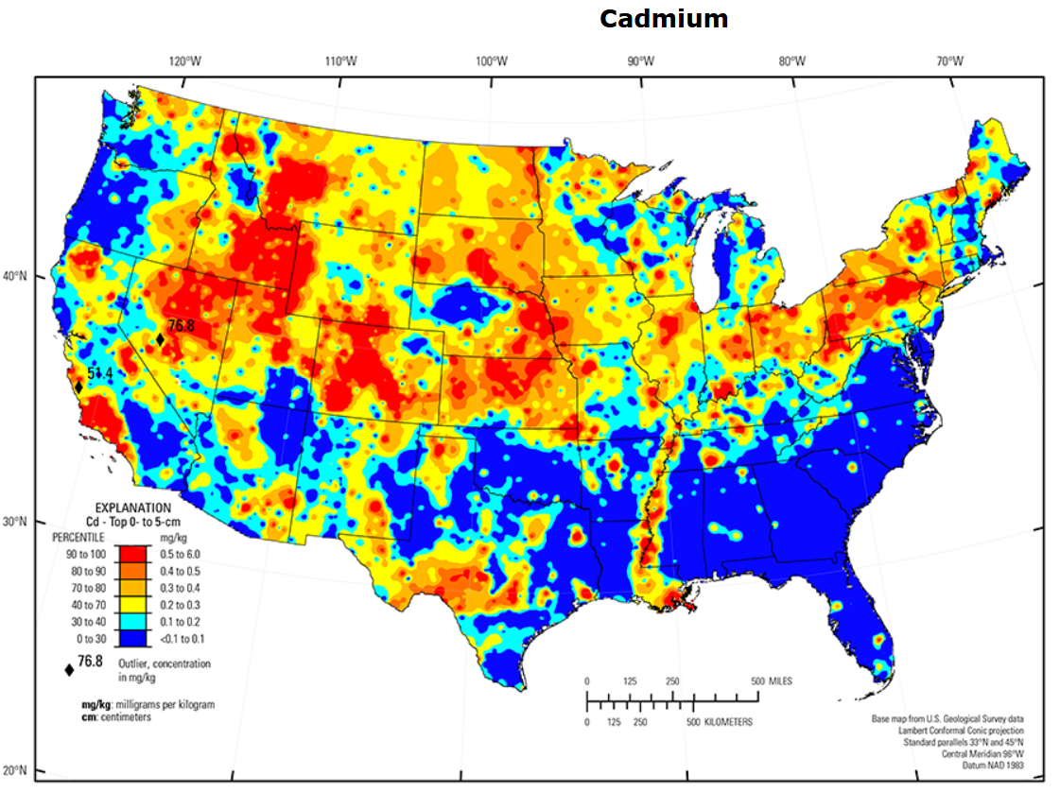
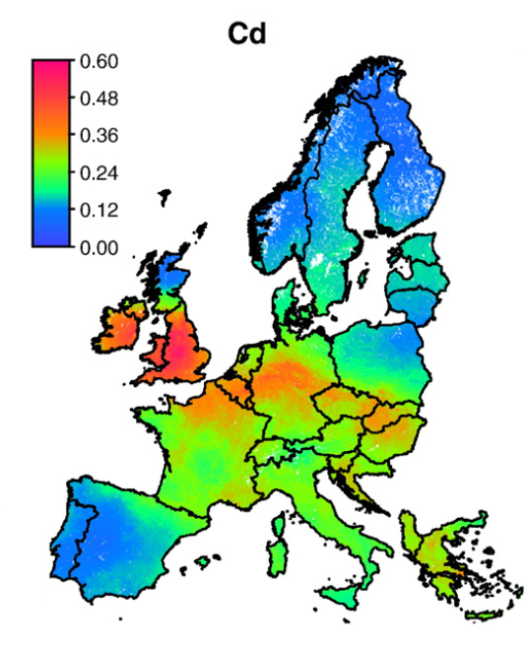
Cadmium in US and European Soils
(Lado et al., 2008; Smith et al., 2019)

Slide 7
Methodology

Slide 8
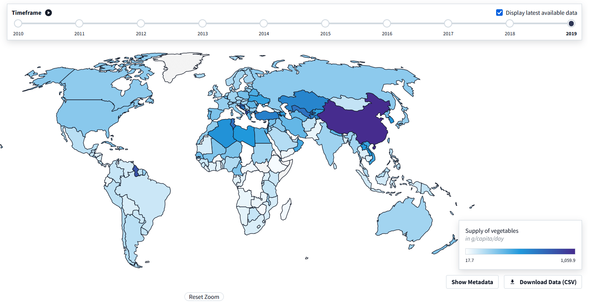
Why China?
China has the highest supply of vegetables in the world – 1059.9 g/capita/day.
The same data is also available as food “consumption” in the website Our World in Data.

Slide 9
Data Collection
“Cadmium China Vegetables” was used as the key search phrase on Web of Science, with a timeframe of 2018 to present.
494 papers were obtained from the search, all of which were examined.
41 out of 494 papers were found to be relevant to this study.
572 data points were generated.
Some criteria for selecting papers:
Must have mentioned the type of vegetable polluted.
pH range must be between 6 and 7.5.
Only bio-available/extractable soil Cd concentration has been considered in this study, as opposed to total soil Cd concentration.
Must be a field study and not a meta-analysis. If it is a meta-analysis, it must lead back to original field research.
Pollution must be due to industrial sources (mining, smelting and so on) or agriculture (fertilizers).
Observed pattern: A lot of the studies showing high Cd concentrations in soil are near mines, smelting or other metal processing plants.

Slide 10
Analysis

Slide 11
Analysis of data points

Slide 12
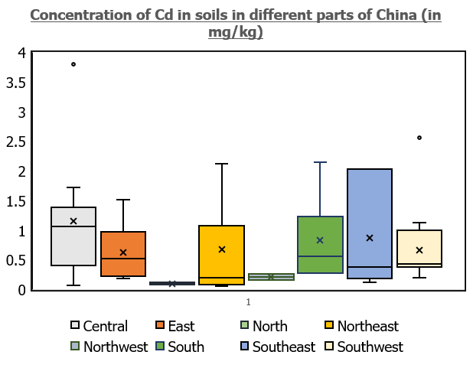
Cadmium in Soil
Region | Median Cd concentration (mg/kg) | Mean Cd concentration (mg/kg)
Central | 1.06 | 1.15
East | 0.52 | 0.62
North | 0.09 | 0.09
Northeast | 0.20 | 0.68
Northwest | 0.21 | 0.21
South | 0.56 | 0.83
Southeast | 0.38 | 0.86
Southwest | 0.43 | 0.66
Overall | 0.49 | 0.79
X = Mean Upper limit of box = 75th percentile
Horizontal line inside the box = Median Lower limit of box = 25th percentile
Vertical lines = Theoretical maximum and minimum based on data distribution
Dots outside the box = Outliers

Slide 13
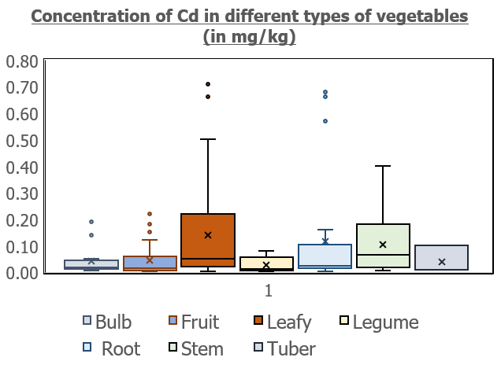
Cadmium in Vegetables
Vegetable type | Median Cd concentration (mg/kg) | Mean Cd concentration (mg/kg)
Bulb | 0.02 | 0.04
Fruit | 0.01 | 0.04
Leafy | 0.05 | 0.14
Legume | 0.01 | 0.03
Root | 0.02 | 0.12
Stem | 0.07 | 0.10
Tuber | 0.01 | 0.04
Overall | 0.03 | 0.09

Slide 14
Correlation Analysis
Expected pre-analysis outcomes:
There should be a correlation between soil cadmium concentration and vegetable cadmium concentration.
The correlation should vary depending upon the type of vegetable.
Only papers which have data for both vegetable and soil concentrations have been considered for this section.
Only vegetables types with a sample size of 10 or more were chosen for this section.

Slide 16
Thresholds
A Cd concentration of 0.2 mg/kg in vegetables is the maximum allowed in China.
This is impacted by soil Cd concentration, its pH, its organic matter among other factors.
However, there is no stipulated standard for soil Cd concentration in China.
Important to keep in mind that soil Cd concentration is not the only determining factor for vegetable Cd concentration.
(Xiao et al., 2018)

Slide 17
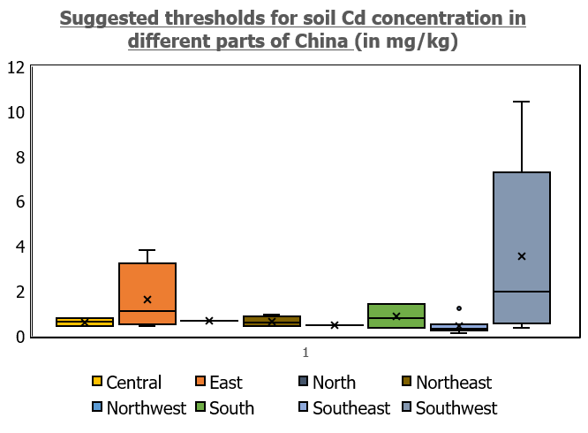
Threshold concentrations from studies
Region | Median Cd threshold in soil (mg/kg) | Mean Cd threshold in soil (mg/kg)
Central | 0.63 | 0.62
East | 1.12 | 1.62
North | 0.67 | 0.67
Northeast | 0.61 | 0.65
Northwest | 0.48 | 0.48
South | 0.80 | 0.87
Southeast | 0.32 | 0.43
Southwest | 1.96 | 3.53
Overall | 0.63 | 1.15

Slide 18

Rewind: Cadmium in Soil
Region | Median Cd concentration (mg/kg) | Mean Cd concentration (mg/kg)
Central | 1.06 | 1.15
East | 0.52 | 0.62
North | 0.09 | 0.09
Northeast | 0.20 | 0.68
Northwest | 0.21 | 0.21
South | 0.56 | 0.83
Southeast | 0.38 | 0.86
Southwest | 0.43 | 0.66
Overall | 0.49 | 0.79
Threshold | 0.63 | 1.15

Slide 19
Rewind: Global Cadmium concentrations
Selected Countries | Cadmium concentration in soil (mg/kg)
USA | 0.27
Australia | 0.01
Brazil | 0.18
Japan | 0.3
Germany | 0.3 – 1
UK | 0.6 – 0.7
Netherlands | 0.5
Global Average | 0.36
Threshold from this study | 0.63 median, 1.15 mean
(Kubier et al., 2019)

Slide 20
Limitations
There are some limitations with the study that could be addressed with more time:
Granularity in vegetable types – There are several “leafy vegetables” (for example) and it would be nice to go further in depth.
Greater sample size to reduce statistical noise (through analyzing more Chinese data from pre-2018 as well as considering other countries).

Slide 21
Limitations
Statistical analysis – More advanced techniques can be used (such as component analysis) to arrive at even better insights.
Exposure analysis – To see how much Cd people are consuming on a daily basis, rather than seeing how much is present in the soil or vegetables.

Slide 22
Main takeaways
Current soil Cd levels are too close to thresholds for comfort.
Agriculture near active/recently closed mining zones is not a good idea.
Uniform Cd standards across regions – be it countries or continents – are required to prevent further pollution, especially for fertilizers.
Current fertilizer standards are insufficient to prevent Cd pollution, especially in the EU.
The link has been established – now more studies are needed to eliminate noise from statistical analysis.
(Ulrich, 2019)

Slide 23
References
November 30, 2022
Genchi, G., Sinicropi, M.S., Lauria, G., Carocci, A., Catalano, A., 2020. The effects of cadmium toxicity. Int. J. Environ. Res. Public Health 17, 1–24. https://doi.org/10.3390/ijerph17113782
Kubier, A., Wilkin, R.T., Pichler, T., 2019. Cadmium in soils and groundwater: A review. Appl. Geochemistry 108, 1–42. https://doi.org/10.1016/j.apgeochem.2019.104388
Lado, L.R., Hengl, T., Reuter, H.I., 2008. Heavy metals in European soils: A geostatistical analysis of the FOREGS Geochemical database. Geoderma 148, 189–199. https://doi.org/10.1016/j.geoderma.2008.09.020
Sigel, A., Sigel, H., Sigel, R.K.O., 2013. Cadmium: From toxicity to essentiality, Metal Ions in Life Sciences.
Smith, D.B., Solano, F., Woodruff, L.G., Cannon, W.F., Ellefsen, K.J., 2019. Geochemical and mineralogical maps, with interpretation, for soils of the conterminous United States, Scientific Investigations Report. Reston, VA. https://doi.org/10.3133/sir20175118
Ulrich, A.E., 2019. Cadmium governance in Europe’s phosphate fertilizers: Not so fast? Sci. Total Environ. 650, 541–545. https://doi.org/10.1016/j.scitotenv.2018.09.014
World Health Organization, 2000. Cadmium.
Xiao, W., Ye, X., Zhang, Q., Chen, D., Hu, J., Gao, N., 2018. Evaluation of cadmium transfer from soil to leafy vegetables: Influencing factors, transfer models, and indication of soil threshold contents. Ecotoxicol. Environ. Saf. 164, 355–362. https://doi.org/10.1016/j.ecoenv.2018.08.041
The 41 papers involved in the meta-analysis have not been cited due to time and space constraints. These will be mentioned in the final paper.

Slide 24
Thank you! Questions and feedback welcome.
November 30, 2022

